Slide 1
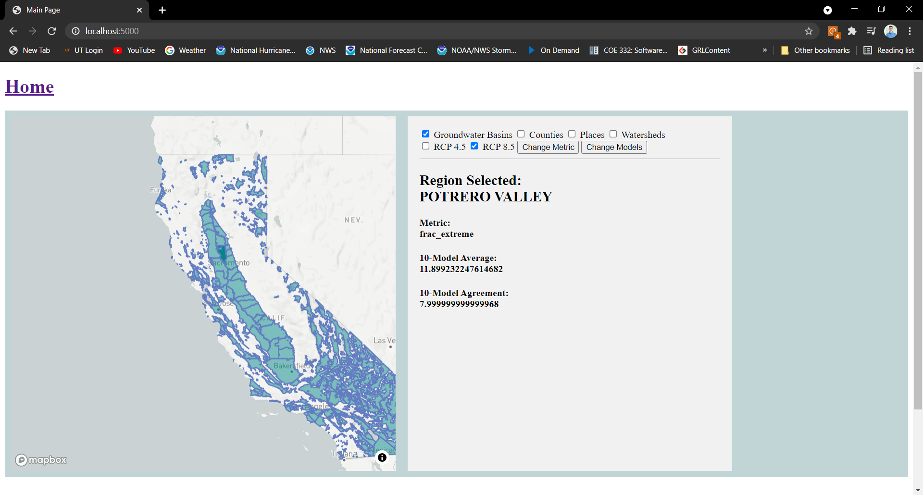

Slide 2
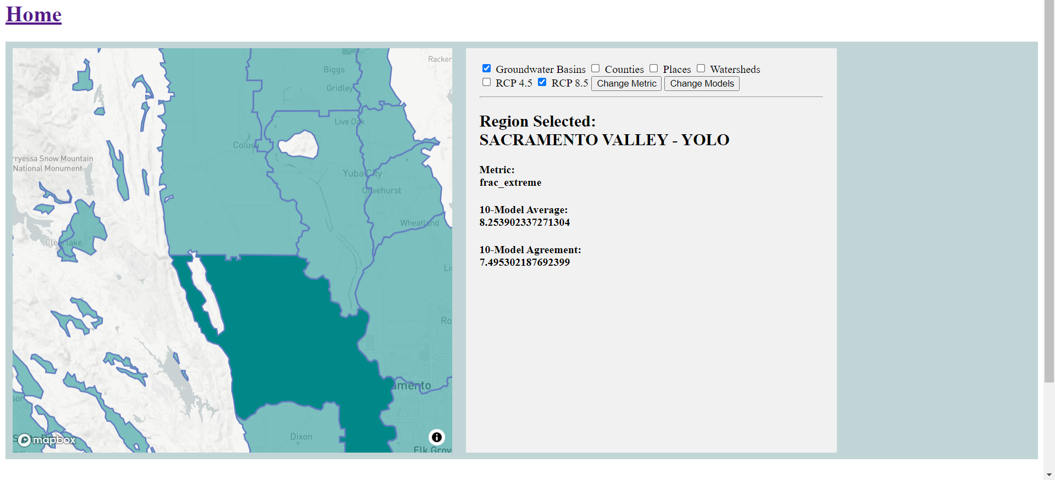
Changes the selected region
Clicking on a region in the map

Slide 3
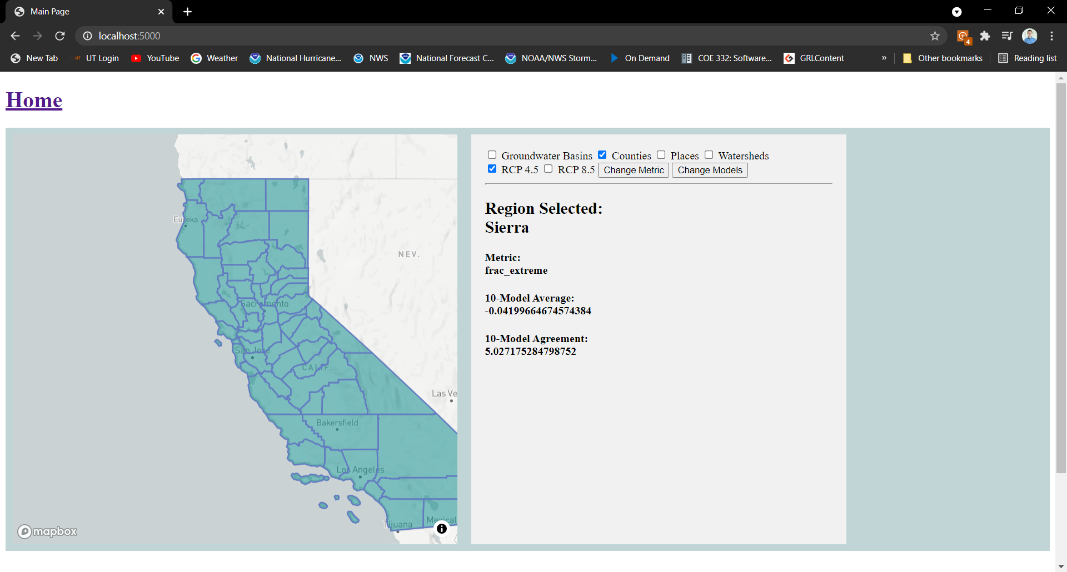
To select the set of regions to display

Slide 4
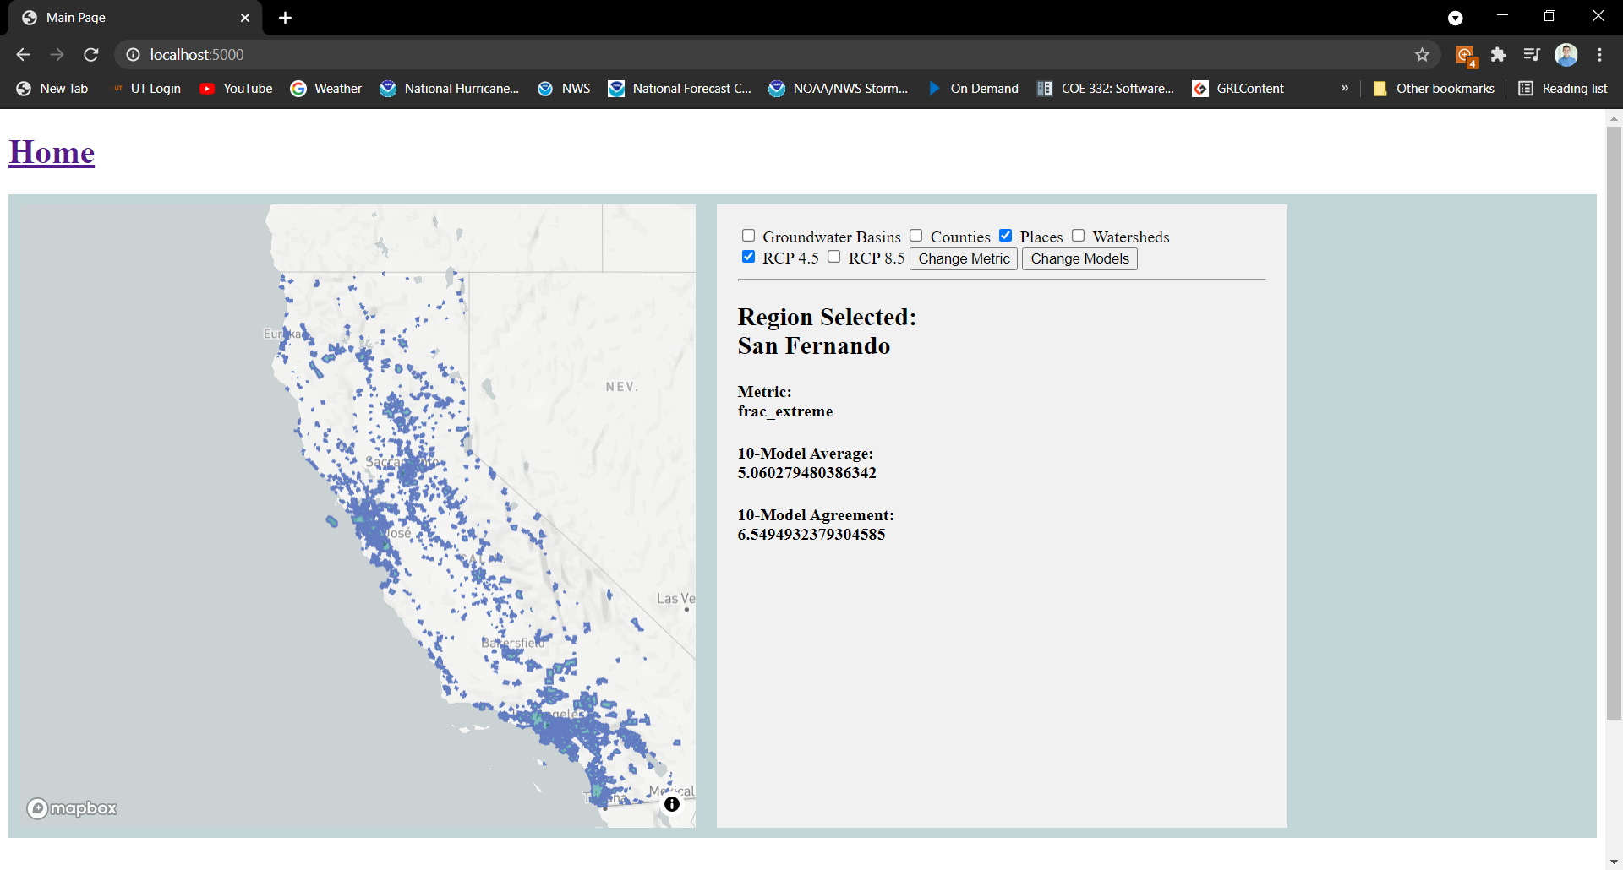

Slide 5
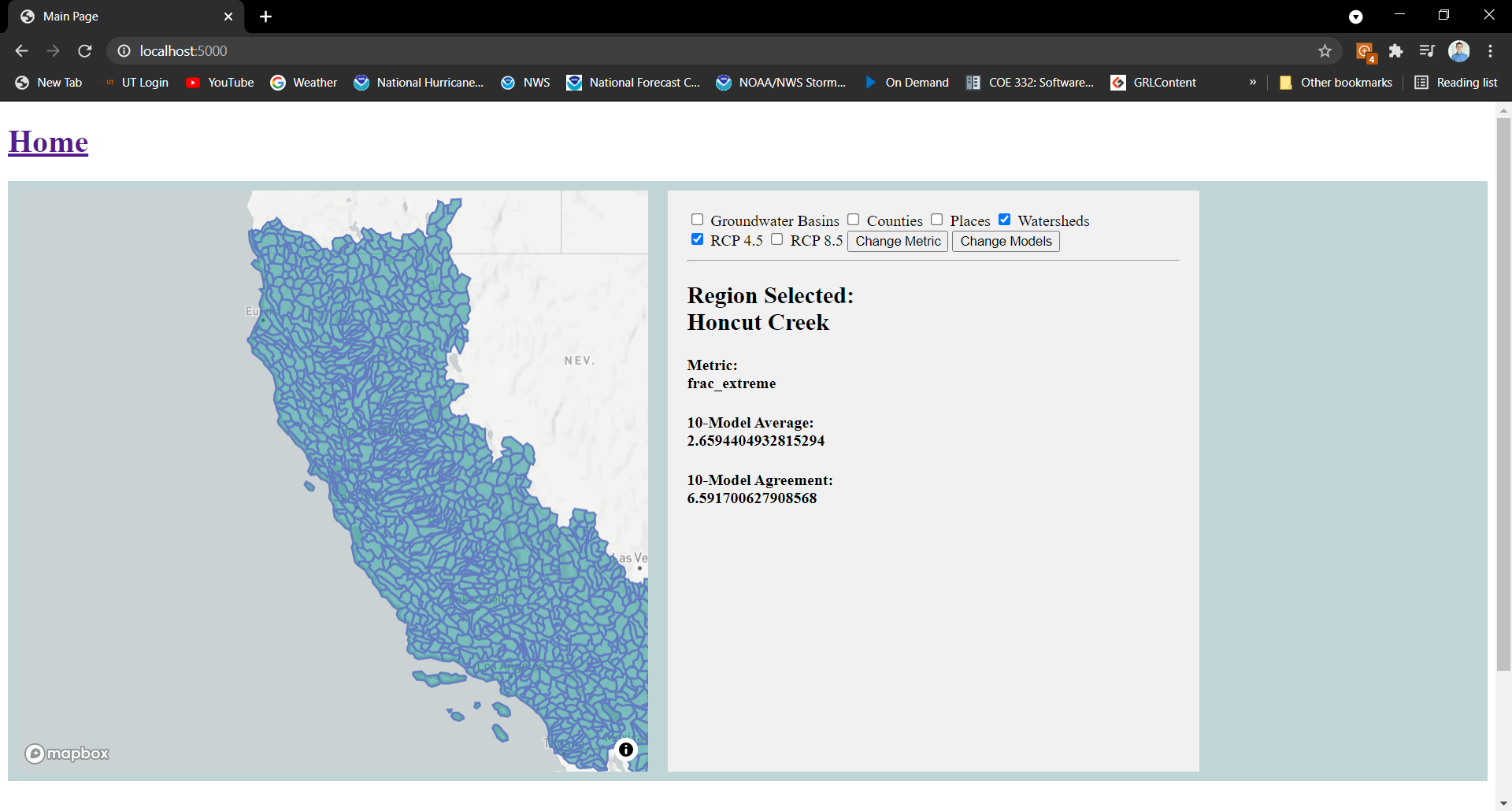

Slide 7
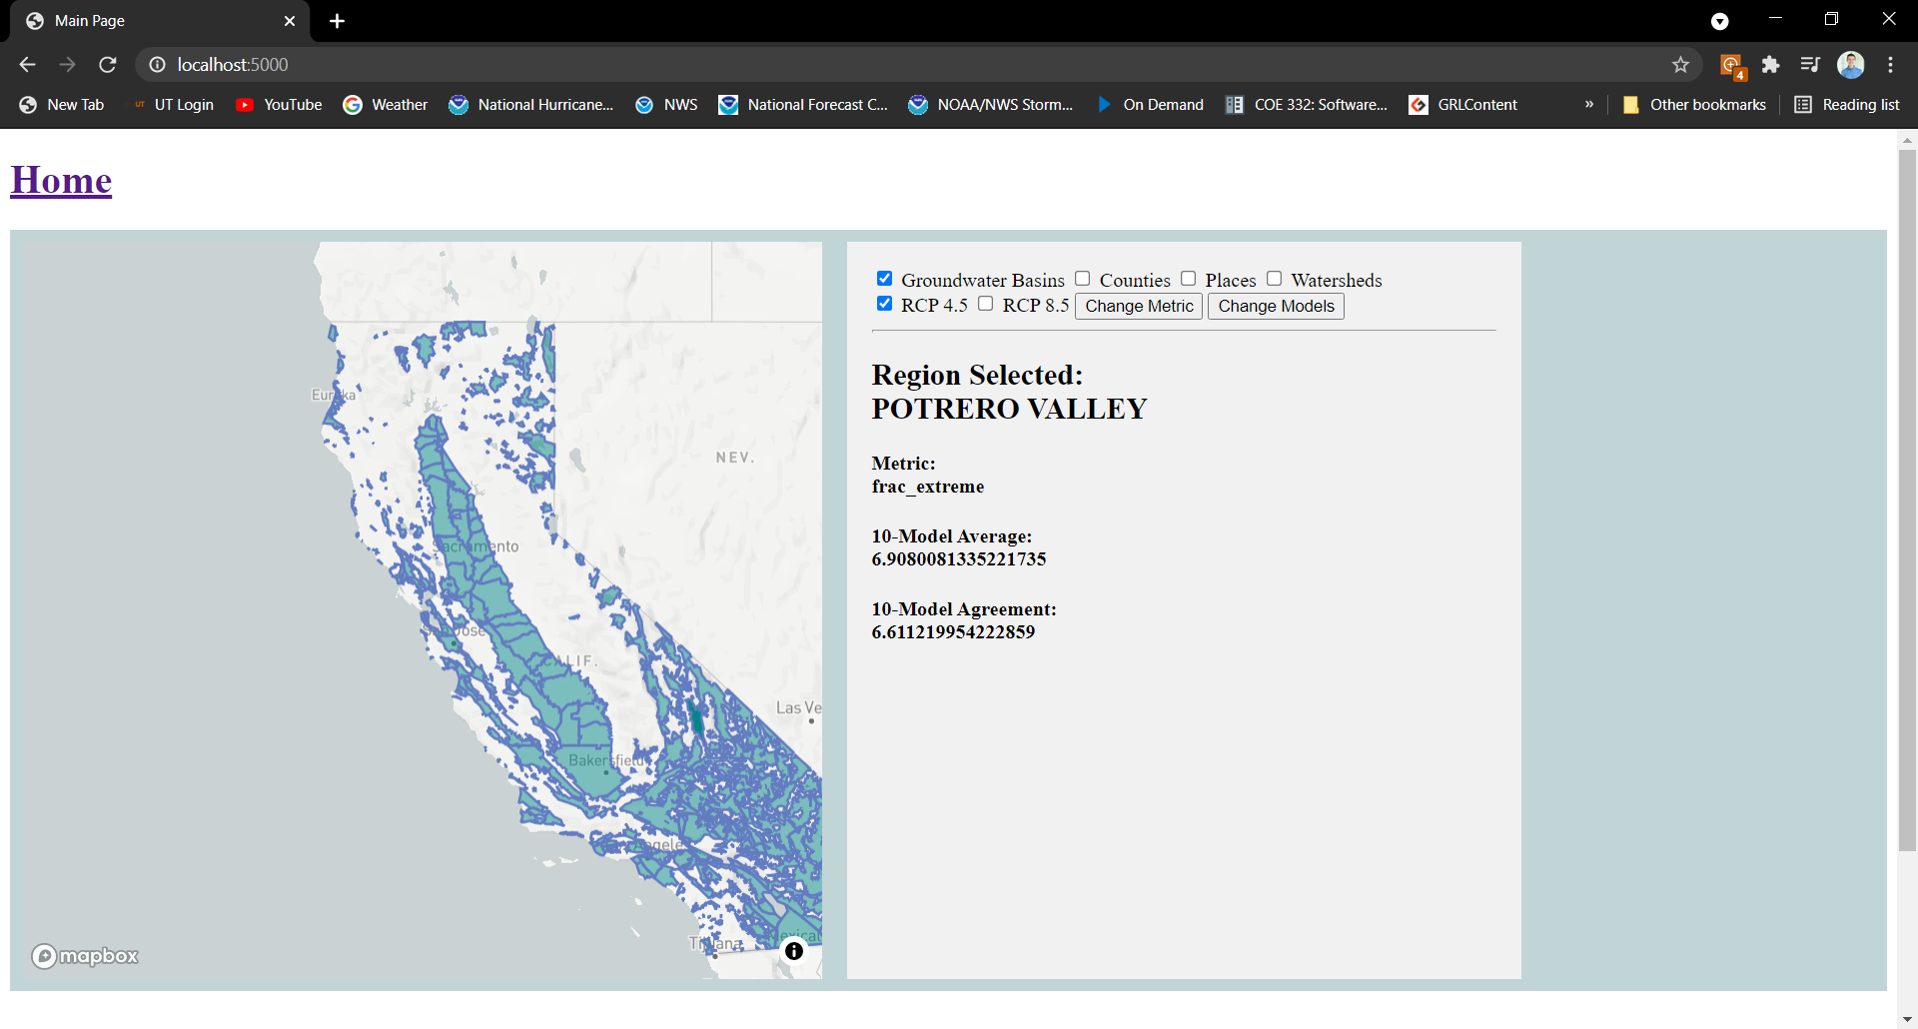
Selecting the desired RCP, notice the change in values

Slide 8
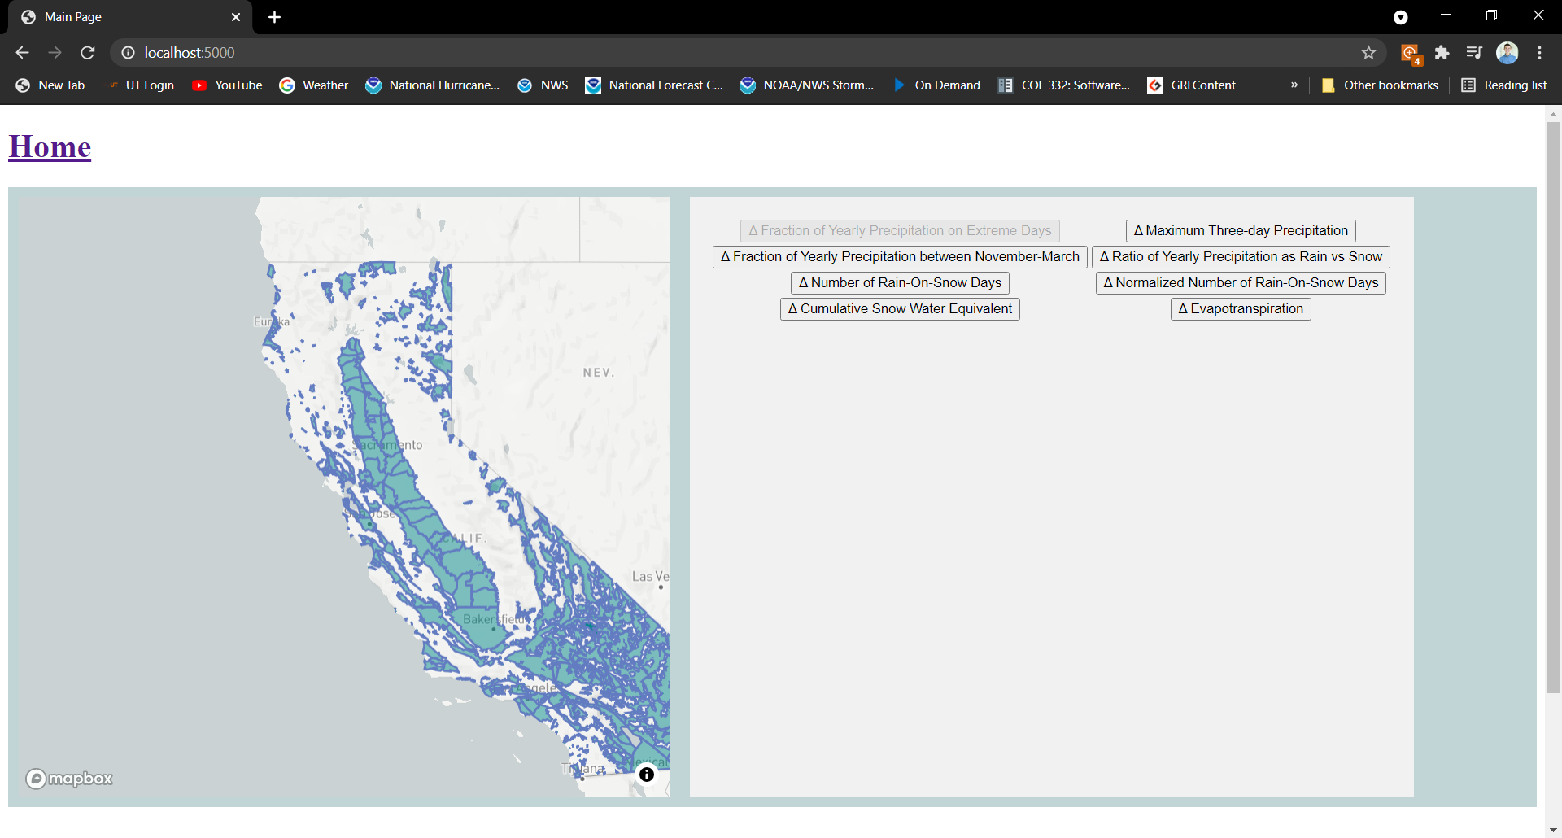
Clicking on “Change Metric” reveals the metrics to choose from

Slide 9

Then by clicking on one of the buttons displayed, changes the metric

Slide 10
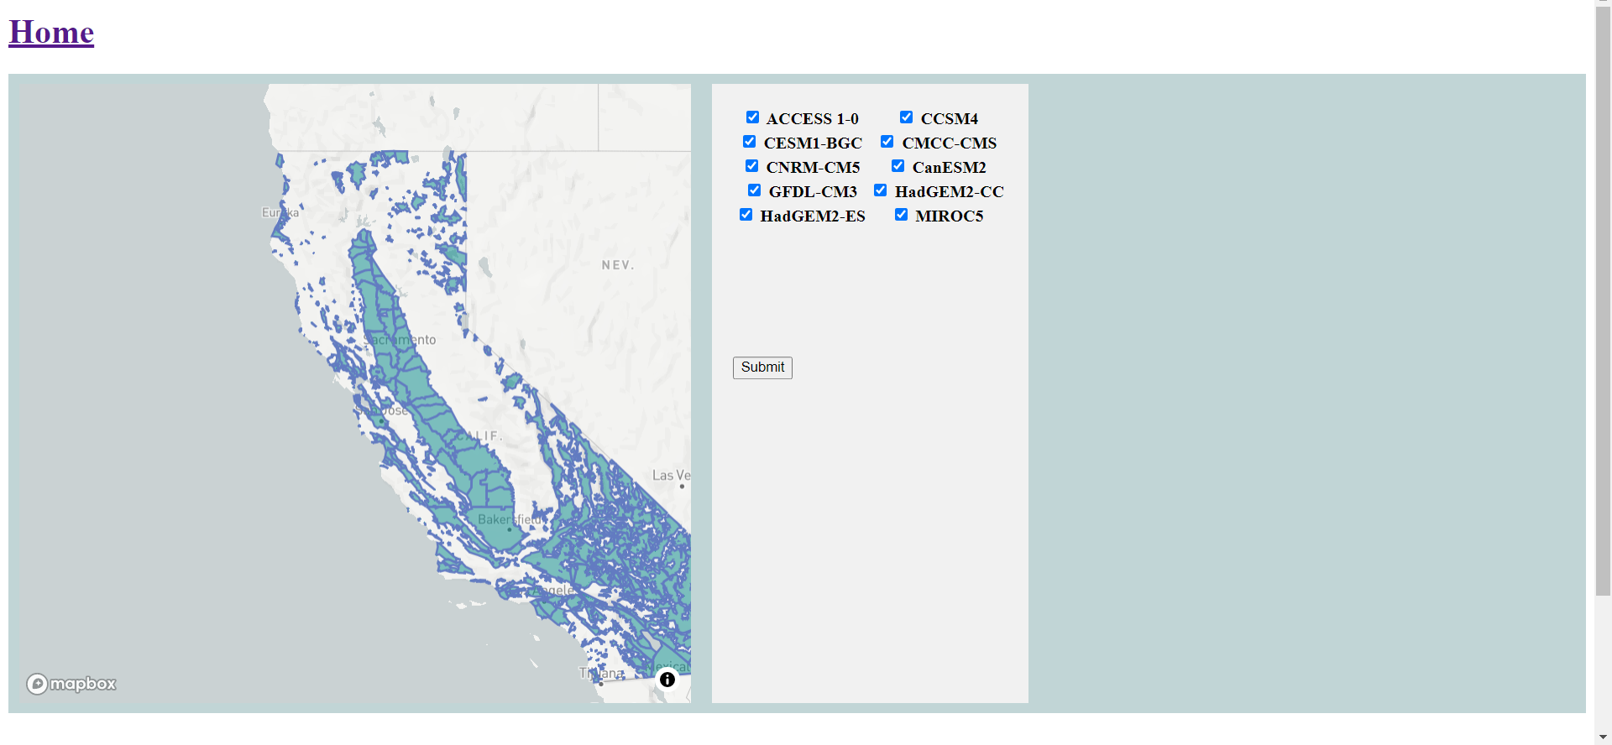
After making selections, submit by clicking this button. It automatically returns to the original display
Changing models hasn’t been implemented yet, but this is what it looks like

